Slide 1


Anekant Education Society’s
Tuljaram Chaturchand College of Arts, Science & Commerce
Baramati
(Empowered Autonomous)
Knowledge Resource Centre (Library)
WELCOME
NAAC PEER TEAM MEMBERS
(Cycle- IV)
Notes:
Reference- :

Slide 2


Our Vision & Mission
To be a vibrant knowledge center, facilitating access to information through innovative services and technology.
Vision
Mission
To provide a diverse collection of resources that supports life long learning, research, and academic success. Help in impairing education & research

Slide 3
About the Central Library (KRC)
  Established since the inception of college in 1962
  Open Access Library
  Library is automated using KOHA updated version
  Strong reference section comprising- 736 Encyclopedias, 565 Dictionaries, Gazetteers and Year Books
  Three reading Halls with 750 seating capacity
  Web-OPAC with enhanced cataloguing search facility
  D-space Institutional Repository providing access to institutional in-house literatures & rare book materials
  User Tracking System
  UPS Back-up & sensor based energy light system.
  CCTV surveillance & Safety Measures
  Disabled Friendly (Located at Basement)

Slide 4
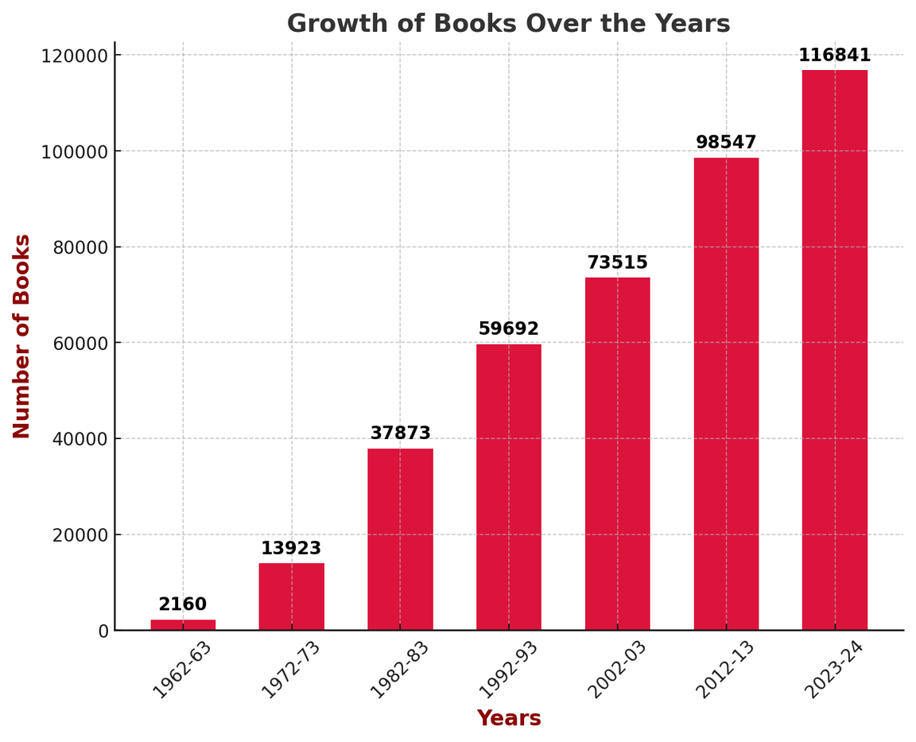
LIBRARY@ GLANCE
  No. of Books in the Library : 1,16,841
Text Book : 54582
Reference Books : 62259
No. of Titles : 68177
Rare Books : 248
  No. of Journals and Magazines : 89
  E-journals & E-books Database : 03
  No.of CD/DVD : 1172
  No. of Newspapers : 12
  No. of Bound Volumes of
  Journals : 3789
  Total Area of the Library : 20886 Sq. Ft

Slide 5
Library Hours
  Circulation (Home Lending): 8.00 AM to 6.00 PM
2. Reading & Internet Section : 8.00 AM to 6.00 PM
During Examinations : 8.00 AM to 9.00 PM
3. Competitive Examination
Study Room : 9.00 AM to 6.00 PM

Slide 6
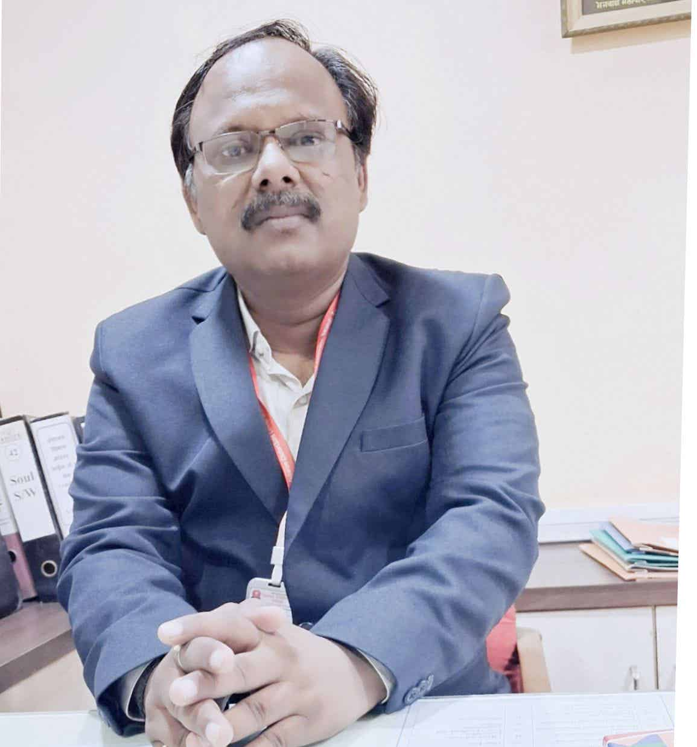
LIBRARIAN PROFILE
❏Experience 15 yrs.
❏Papers Published: 12 (UGC Care listed: 3)
❏Delivered Lectures as Resource Person: 2
❏Representing in various bodies of college
❖Nodal Officer, IRINS INFLIBNET
❖Member, E-content Development
❖Secretary, Library Advisory Committee
❖Coordinator competitive Examination
Centre
❖Member, College Magazine
Committee
Dr. Amar K Kulkarni
LIBRARIAN
B.Sc., MLIS, Ph.D.

Slide 7
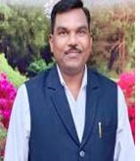
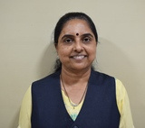
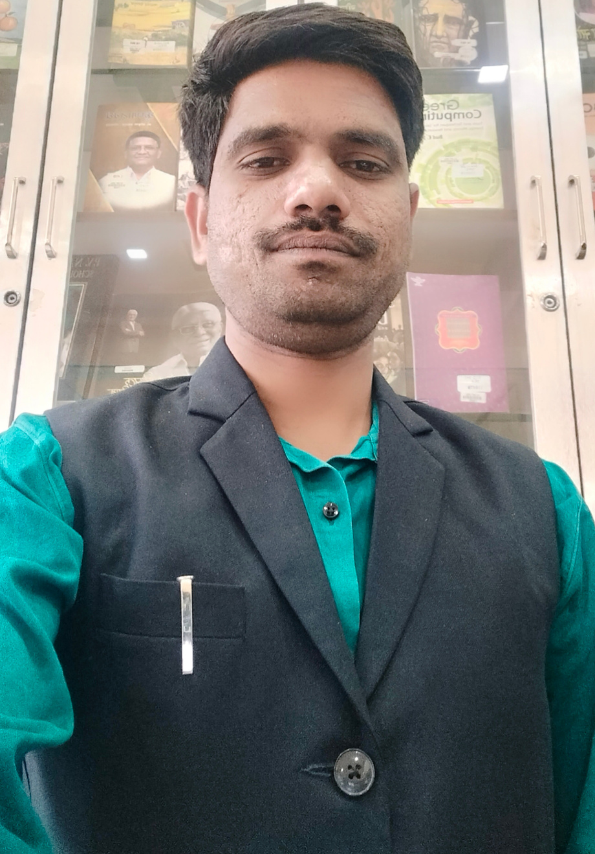
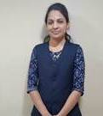
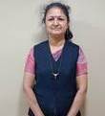
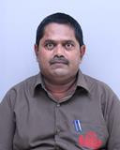
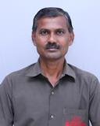
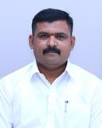
Mr. Nitin Bhosale
Library Clerk
Meet Our Team
Mrs. Sarika Vohra
Library Clerk
Mrs. Varsharani Raut
Library Clerk
Mr. Nitin Londhe
Library Clerk
Mrs. Priyanka Sonwalkar
Library Clerk
Mr. Babasaheb Puri
Lib. Att.
Mr. Shashikant Shelar
Lib. Att.
Mr. Satish Jadhav
Lib. Att.

Slide 8
LIBRARY ADVISORY COMMITTEE
Principal Dr. Avinash Jagtap, Chairman
Members
Dr. Ashok Kalange (Vice Principal)
Dr. Sachin Gadekar (Vice- Principal)
Dr. Yogini Mulye (Vice- Principal)
Mr. Abhinandan Shah (Registrar)
Dr. Ajit Telave (Botany Department)
Dr. Wajid Khan (Head, Food Science)
Dr. Sunil Pawar (CDC Member)
Dr. Mukta Ambhere (CDC Member)
Mr. Rajesh Mehta (CDC Member)
Dr. Amar Kulkarni , Librarian and Member Secretary

Slide 9

Library Advisory Committee Meetings
❖The Committee meets twice a year
❖The committee makes recommendations,
forms policy for library administration,
collection development, annual budget, etc.
❖The committee reviews the grievances regarding
library and acts upon the same.
❖Major recommendations of the committee
❏ Digitization of manuscripts and ‘Anekant’ Annual
❏ Make availability of Plagiarism Detection Software
❏Subscribe J-gate Database and American Library “Dosti House” Membership
❏Increase budget for reference books to meet the requirement of
research programs

Slide 10

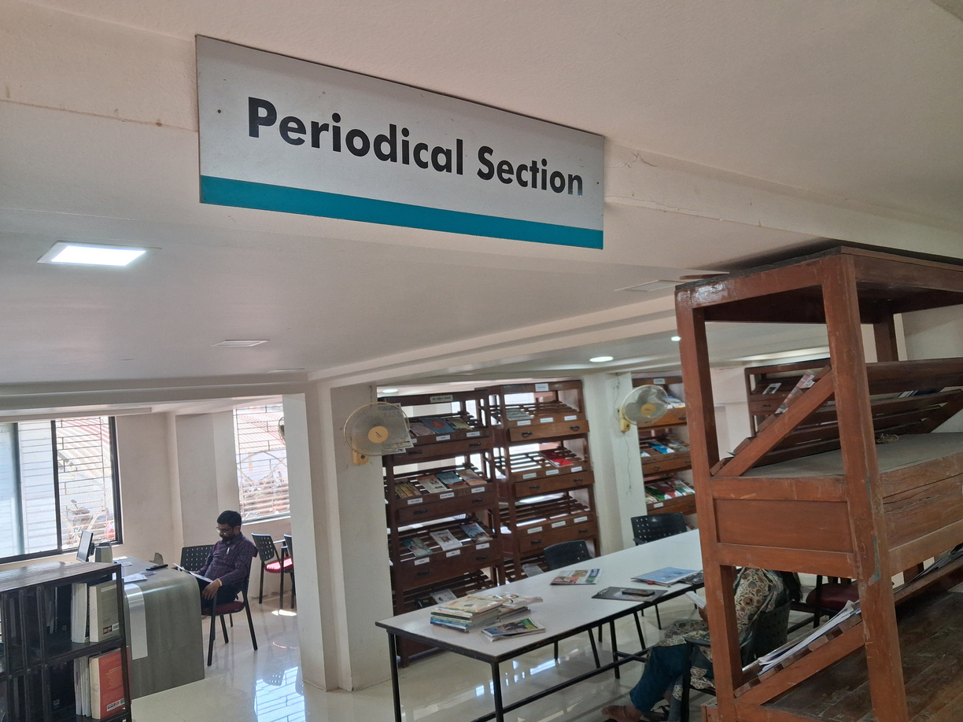
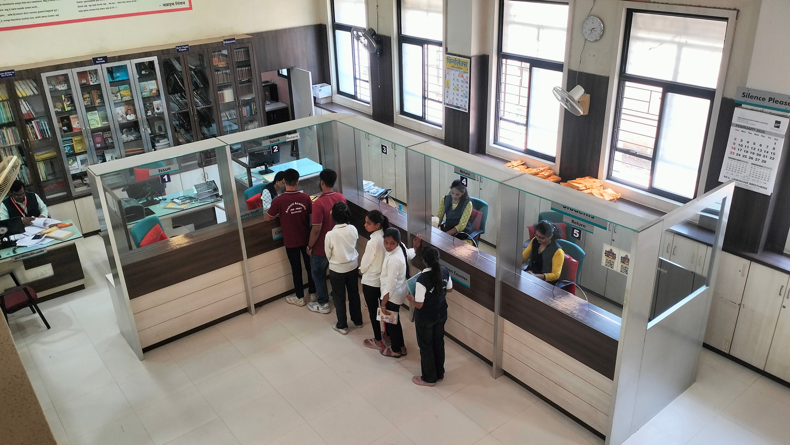
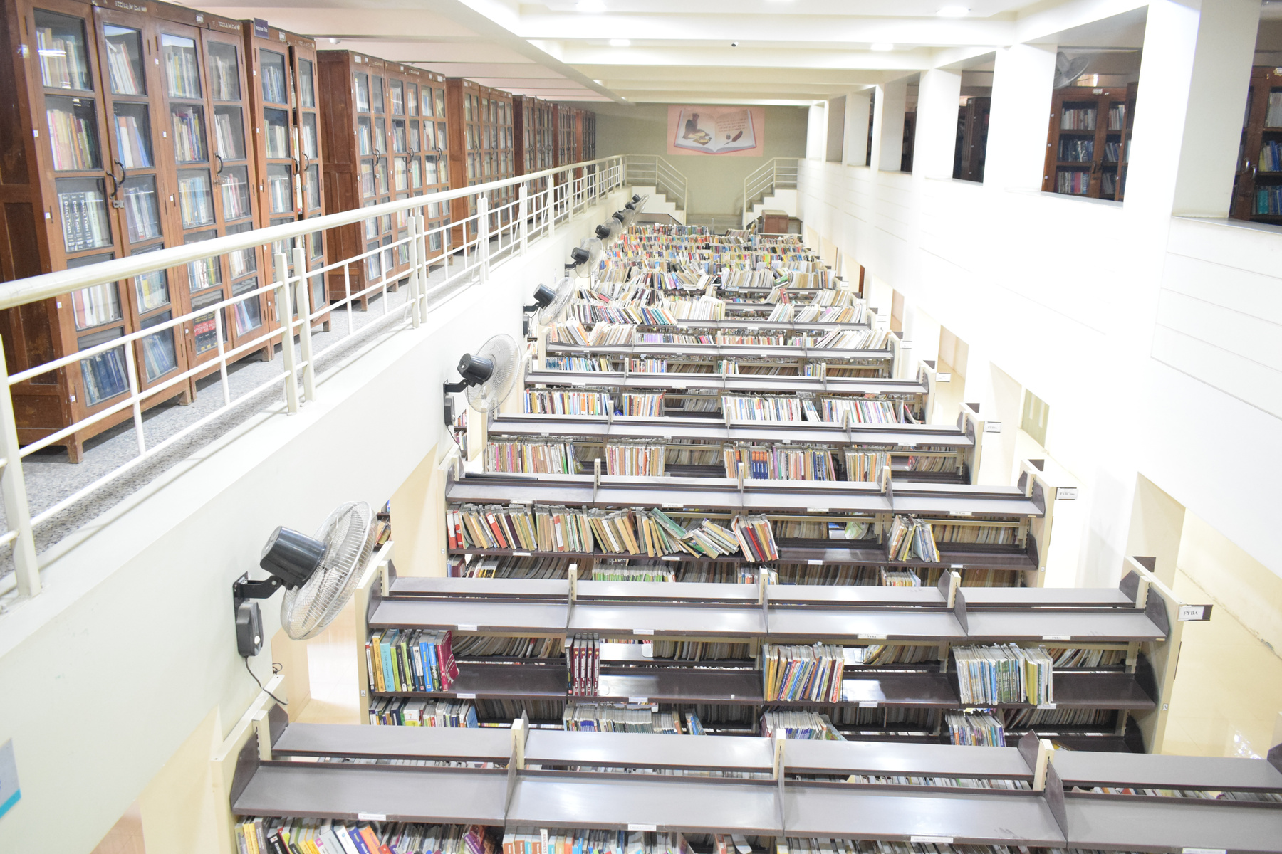
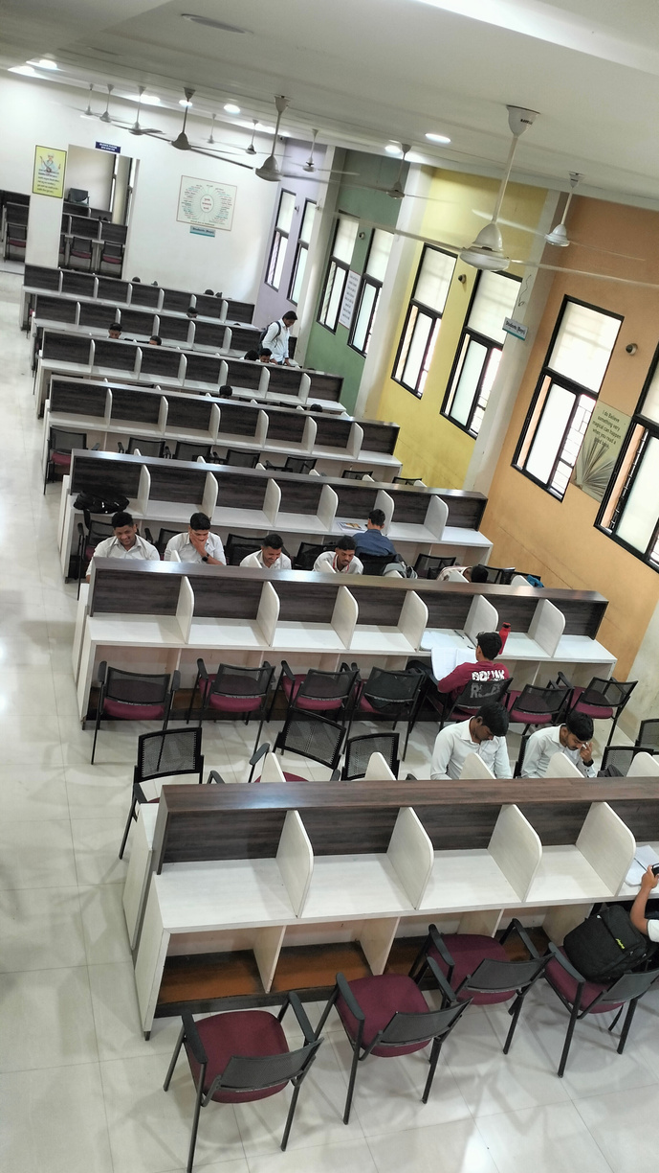
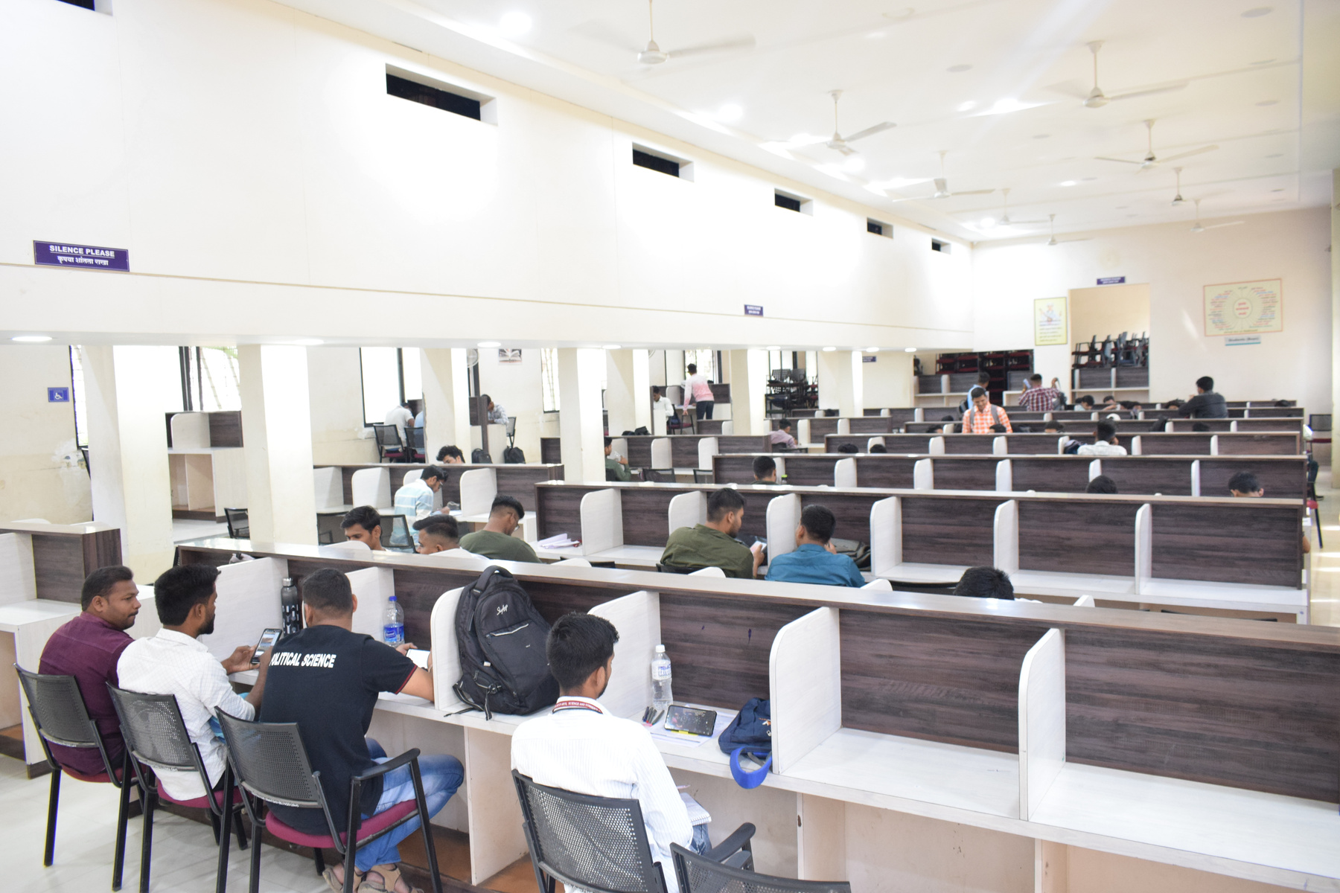
Library Infrastructure @ Glance
Periodical Section
Issuing Counter
Stacking Section
Reading Room (Ground)
Competitive Exam Study

Slide 11
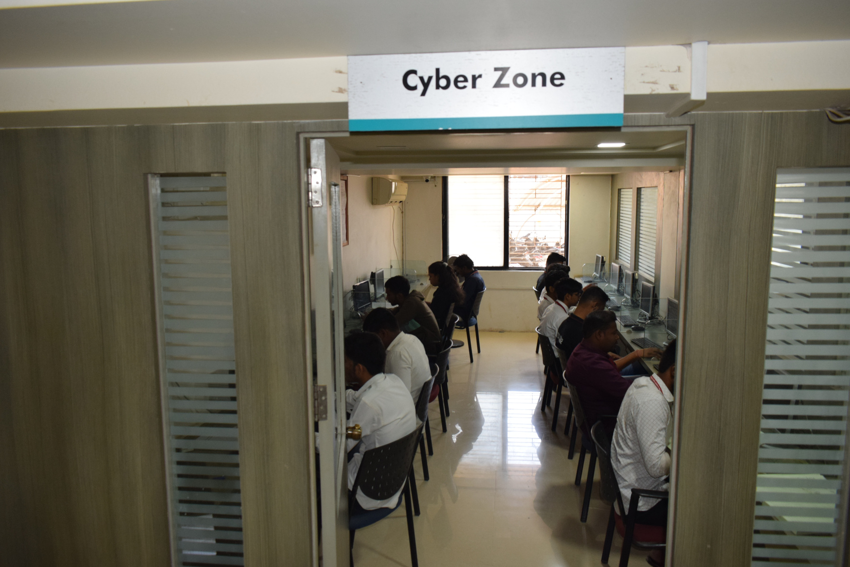
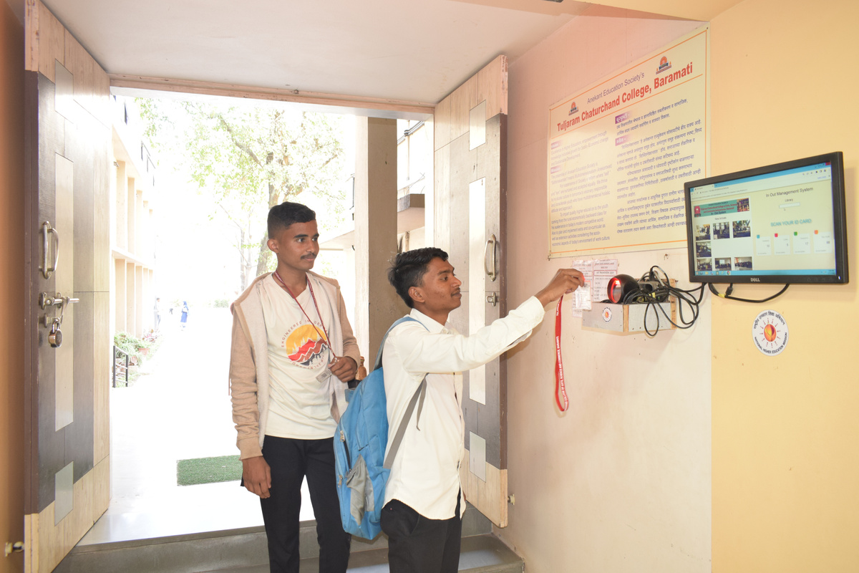
Library Infrastructure
  Computers for Working : 10
  Reading Hall : 03
  Seating Capacity : 750
  Cyber Zone : 02
  Computers : 23
  Document Scanner : 01
  Barcode Printer : 01
  User Tracking System : 04
Built - up Area
20,886 Sq. Ft.

Slide 12
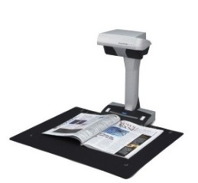
LIBRARY NOW & THEN
Particulars
Now (Cycle - IV)
Then (Cycle III)
  Library built up area in sq. fits.
20886
  12887
  No. of Books on Accession
116841
  109853
  Library Software
KOHA (23.11.06)
  SOUL 2.0
  Instituional Repository
D- Space (Web version)
  Nil
  OPAC
Web OPAC
  Nil
  Cyber Zone (Internet Facility)
2 Cyber Zone (23 Computers)
  1 Cyber Zone (12 Computers)
  Reading Hall Occupancy
3 Reading Hall (750 Capacity)
  1 Reading Hall (230 Capacity)
  E- Resources
3 N-list, J-gate (Basic Science), J-gate (Arts & Humanities), American Library Dosti House , NDLI
  N-list
  User Tracking System
In Place Functional
  NIL

Slide 13
LIBRARY SERVICES
News Paper Clipping & Career Bulletin Display
Library Training/Orientation Program
Book Exhibitions & Reading Awareness Programmes
Current Awareness Services (New Arrivals/Book Display)
E-Journals, E-Books & Databases
Inter Library Lending
Plagiarism Detection Services : Drill-Bit
Help in Research Profile Creation (IRINS)
Help for applying ISBN

Slide 14
LIBRARY FACILITIES
Open Access Library with amply collection of Journals / Magazines/News Paper, E-books, E-Journals & databases
Free Internet/Wi-Fi Facility and well furnished separate two cyber zones
Three Well developed Ambience Reading Hall & good collection of books for Competitive Examination preparation.
Strong Reference Books Section & Book Bank facility
State-of art Library Web- OPAC & Institutional Repository : DSpace
Facilitation for Divyang Jan, Braille Section for visually impaired readers

Slide 15
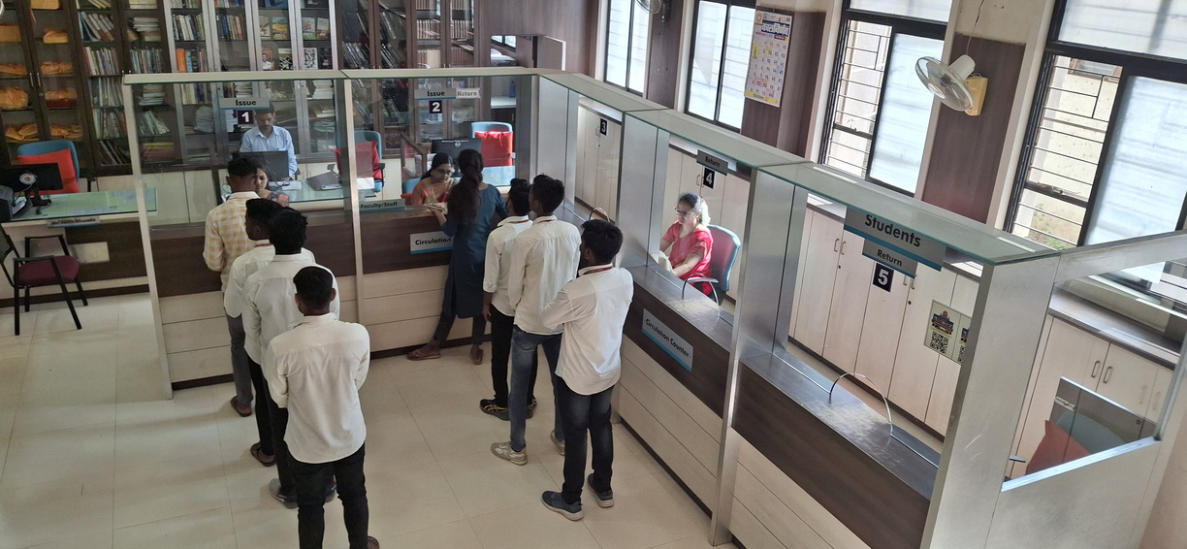
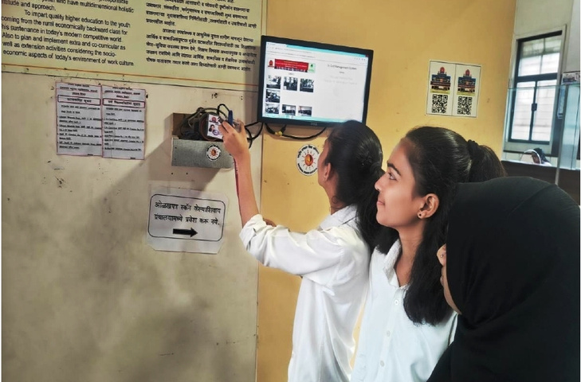
Use of Library by Faculty & Students
Year | Faculty | Students | Total (Lakh)
2023-2024 | 5156 | 155910 | 1.61
2022-2023 | 4252 | 174900 | 1.80
2021-2022 | 3692 | 80725 | 0.84
2020-2021 | 3717 | 1139 | 0.49
2019-2020 | 4802 | 143555 | 1.48
TOTAL | 21619 | 556229 | 5.79

Slide 16
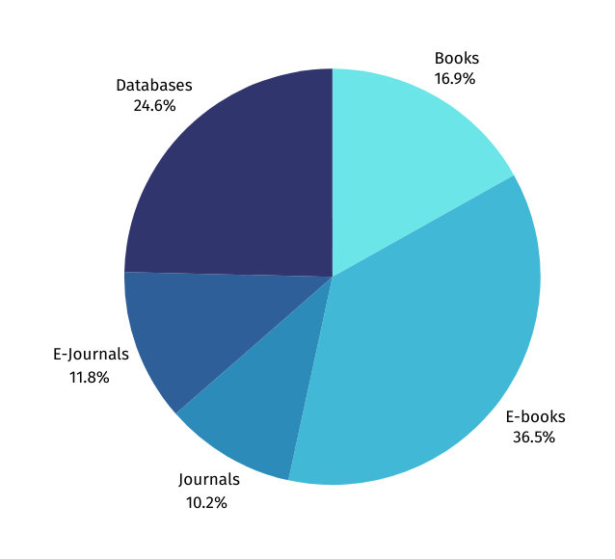
Expenditure on Purchase of Books/E-books/ journals/ E-journals in last 5 Years in Lakh
YEAR | Books (Print) | E- books | Journals | E-Journals | Database | Total
2019-20 | 3.17 | 2.34 | 2.36 | 0 | 0 | 7.87
2020-21 | 0.68 | 19.89 | 0.75 | 1.69 | 5.39 | 28.4
2021-22 | 1.24 | 1.1 | 0.84 | 1.77 | 11.08 | 16.03
2022-23 | 3.6 | 6.53 | 1.94 | 3.4 | 1.54 | 17.01
2023-24 | 5.11 | 0.00 | 2.43 | 2.8 | 2.12 | 12.46
Total | 13.80 | 29.86 | 8.32 | 9.66 | 20.13 | 81.77

Slide 17


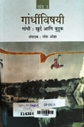
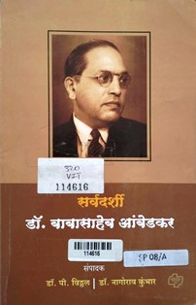
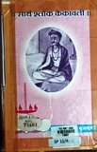

Our Special Collection
Sr. No | Particulars | Total Books | Link
1 | Jainism | 1459
2 | Competitive Exam | 1434
3 | Mahatma Gandhi | 297
4 | Rare Books | 248
5 | Dr. Babasaheb Ambedkar | 130
6 | Vet. Poet Kavivary Moropant | 41
Jainism
Competitive Exam
Mahatma Gandhi
Vet. Poet Kavivary Moropant
Rare Book
Dr. Babasaheb Ambedkar

Slide 18
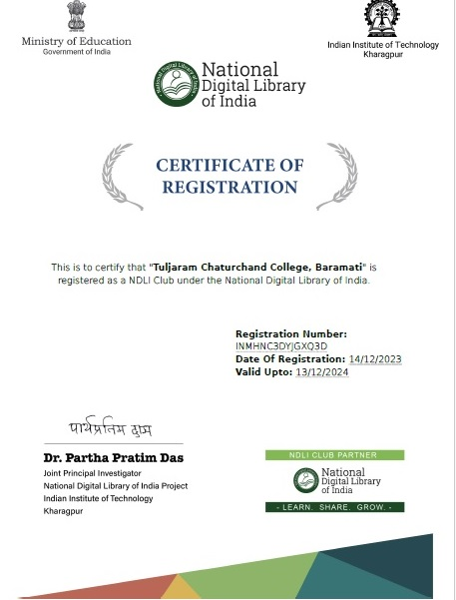
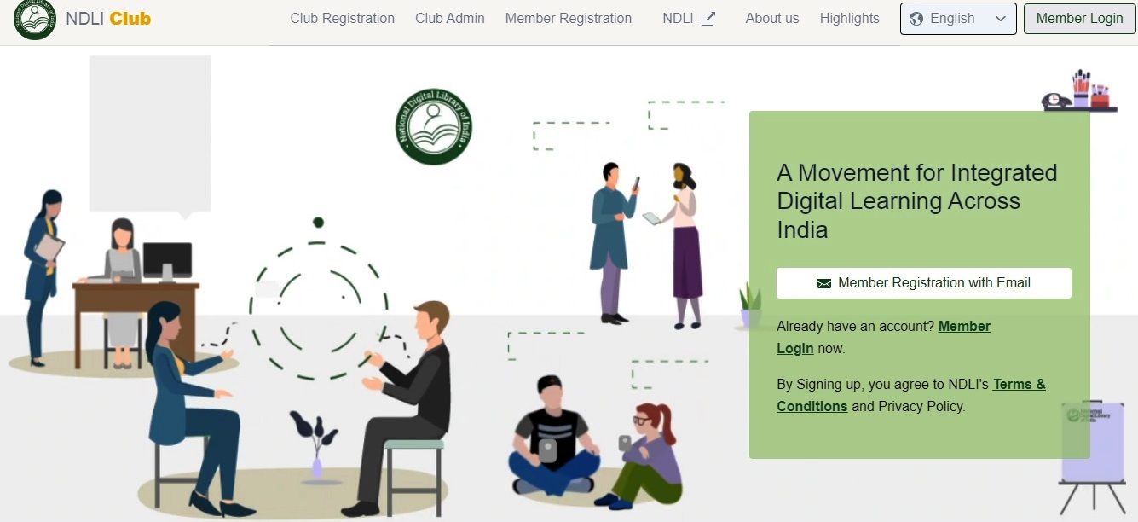
National Digital Library of India CLUB @ KRC
Successfully Created and Established NDLI CLUB @ our college Library (KRC)

Slide 19
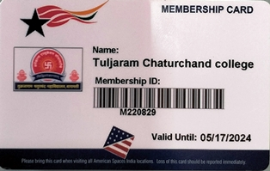
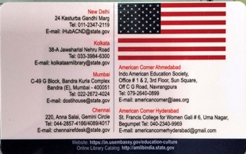
Library Membership
Member of – American Library , Dosti House,
Mumbai

Slide 20
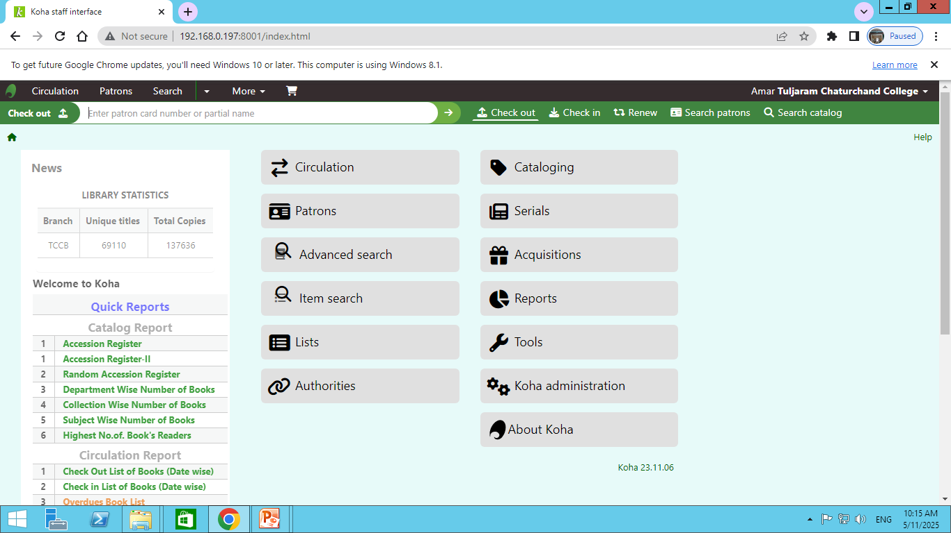
KOHA ILMS (23.0.11)

Slide 21
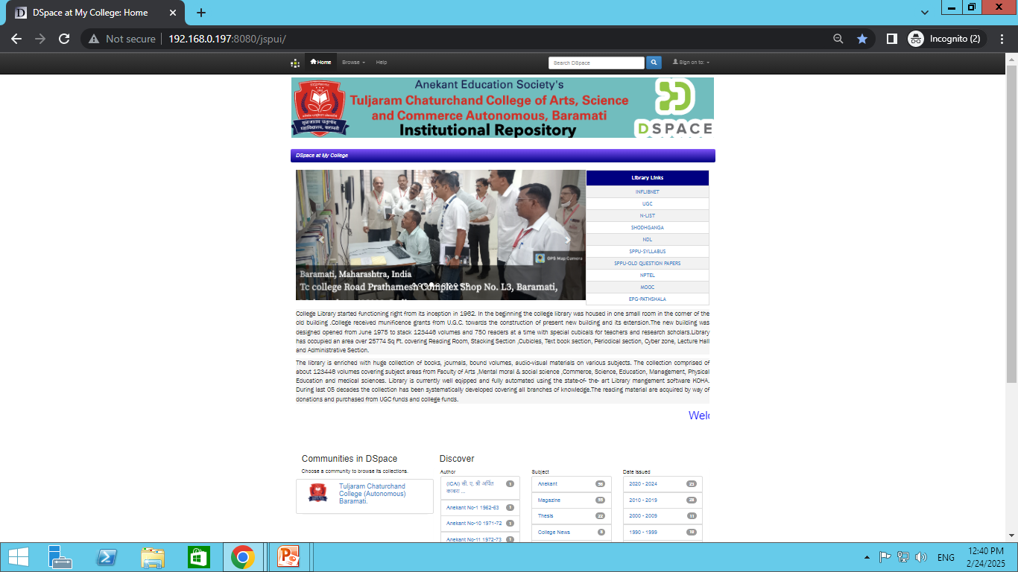
D-Space Institutional Repository
Successfully Created and EstablishedCLUB @ our college

Slide 22
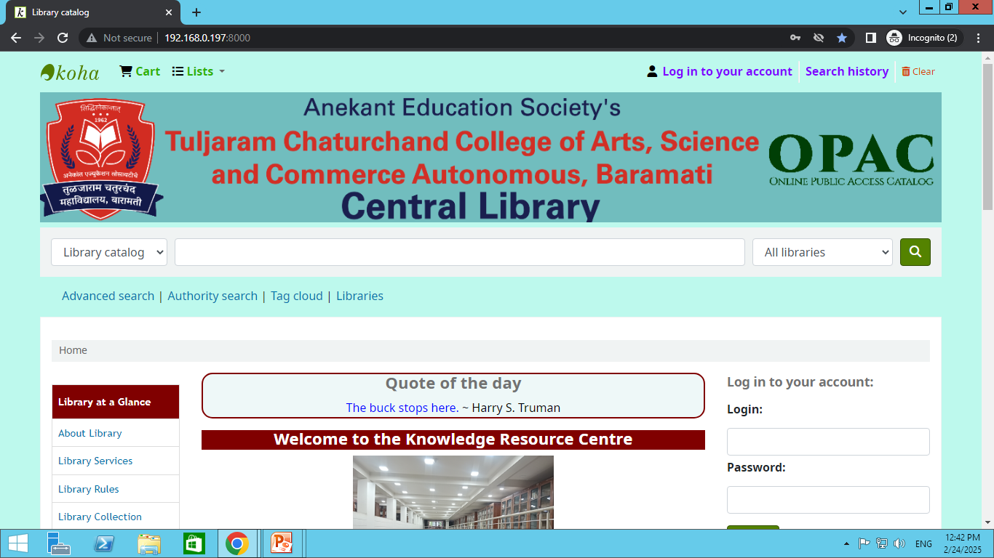
Library Online Public Access Catalogue (Web Version)

Slide 23
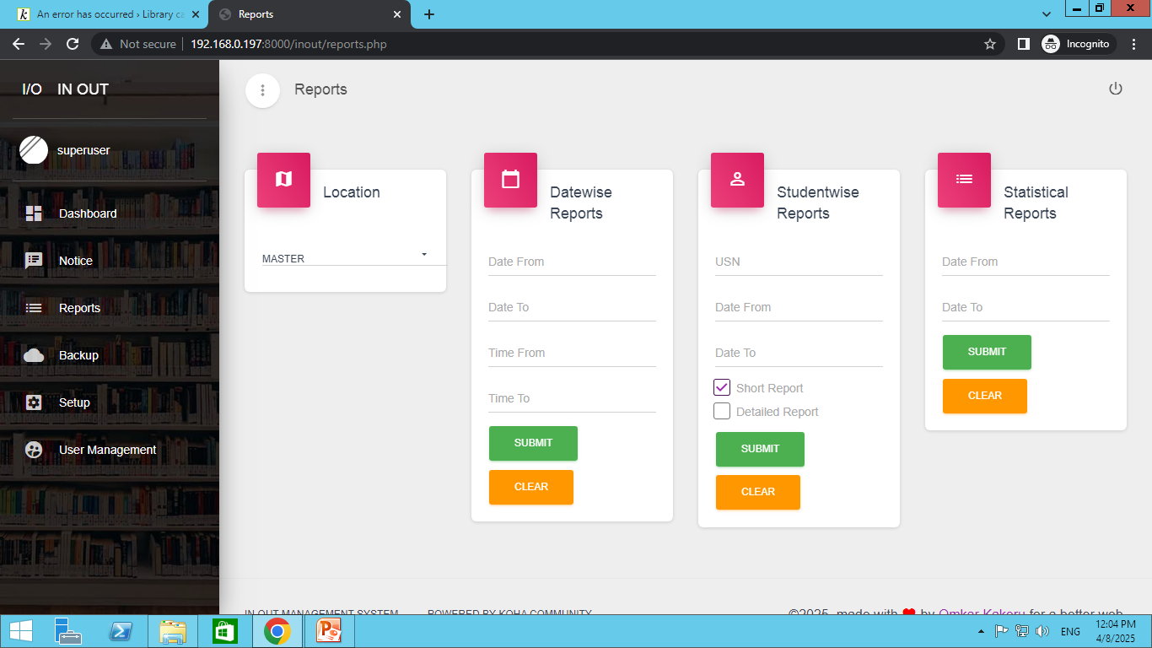
Library in-out management system (Web Version)

Slide 24
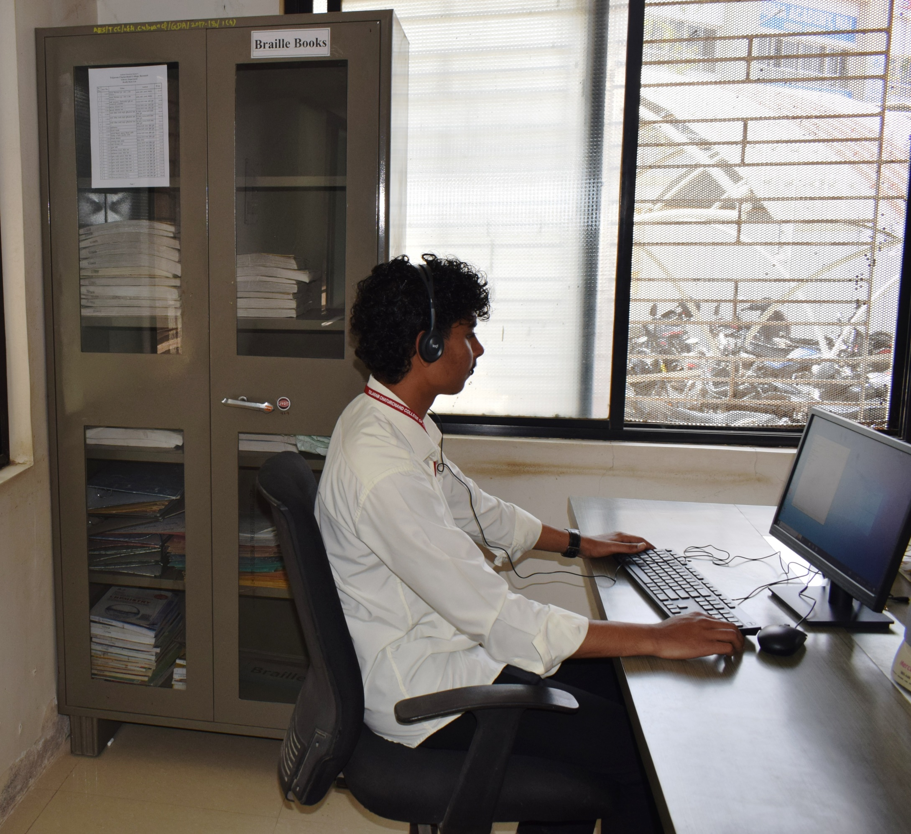
Braille Section
NVDA Software (Open Access)
Braille Books – 25 (prints)
Audio-Cassettes, audio books
Music CD/ DVD

Slide 25
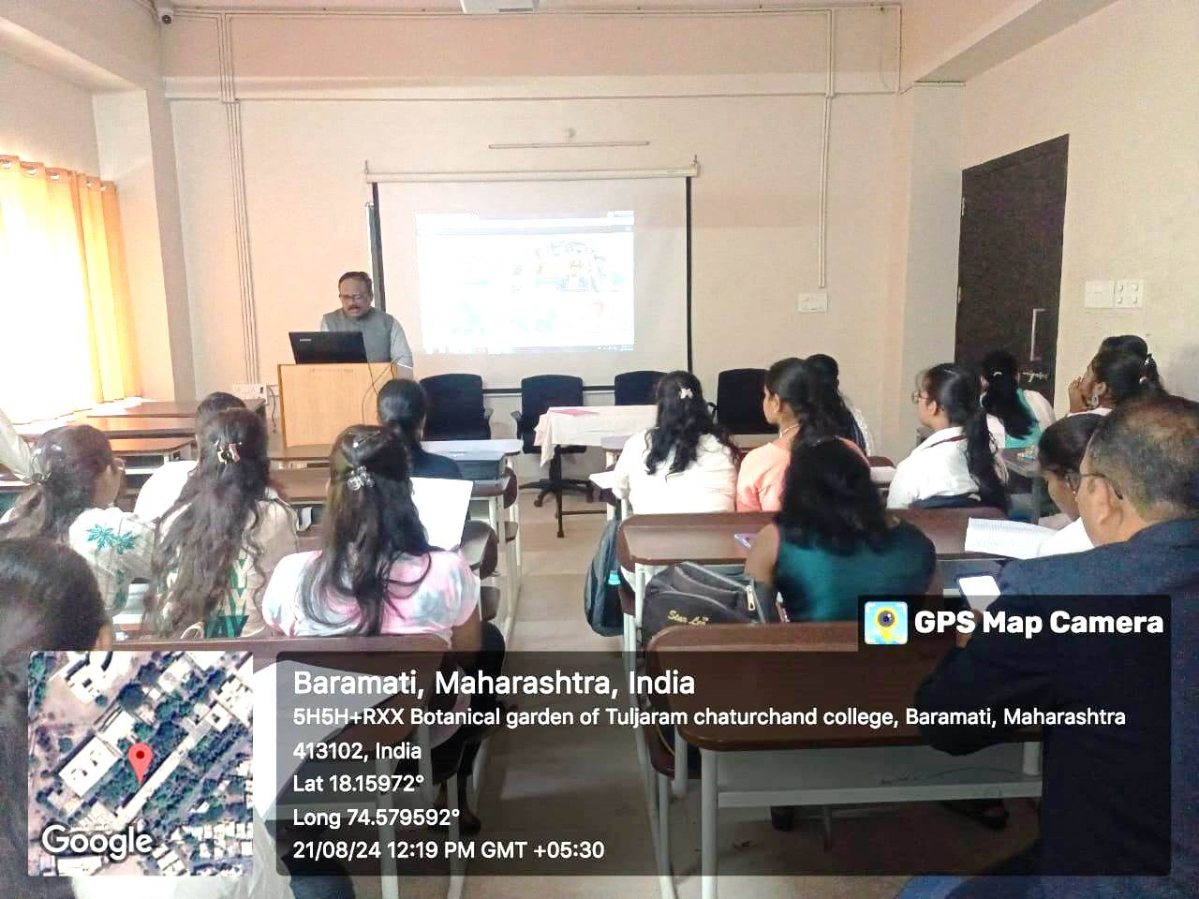
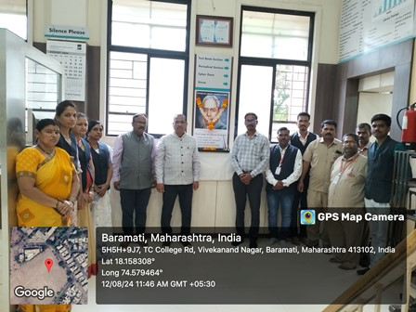
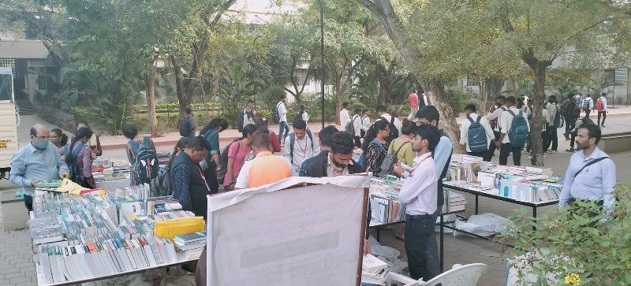
Library Various Activities
Sr. | Activities Name | Total Activities (2019-2024)
1 | Orientation Program | 06
2 | Workshops (E-resources , Plagiarism Awareness) | 05
3 | Vachan Prerna Din (18 Hrs. Reading ) | 05
4 | Celebration of Dr. S.R. Ranganathan Birth Anniversary | 05
5 | Book Exhibitions | 06
 | Total | 27

Slide 26
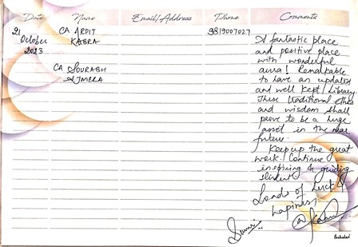
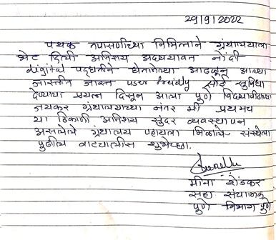
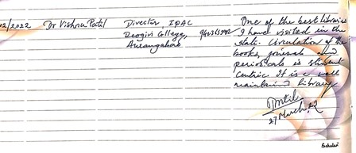
Some Prominent Remarks of Library Visitors
Sr. No. | Date | Name of Visitor
1 | 21/10/2023 | Arpit Kabra ( C.A.)
2 | 27/12/2022 | Dr. Vishnu Patil (Director IQAC Deogiri College , Aurangabad)
3 | 29/09/2022 | Mena Shendkar (Joint Director Pune Division)

Slide 27
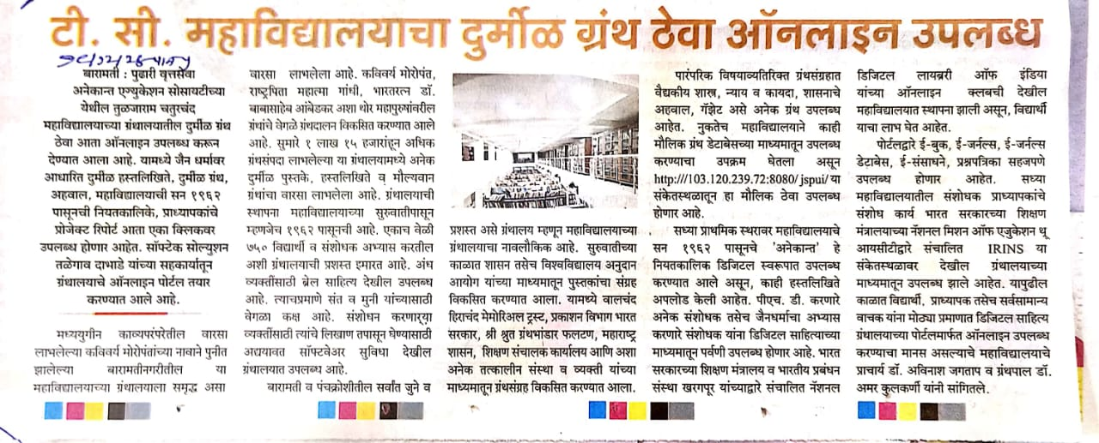
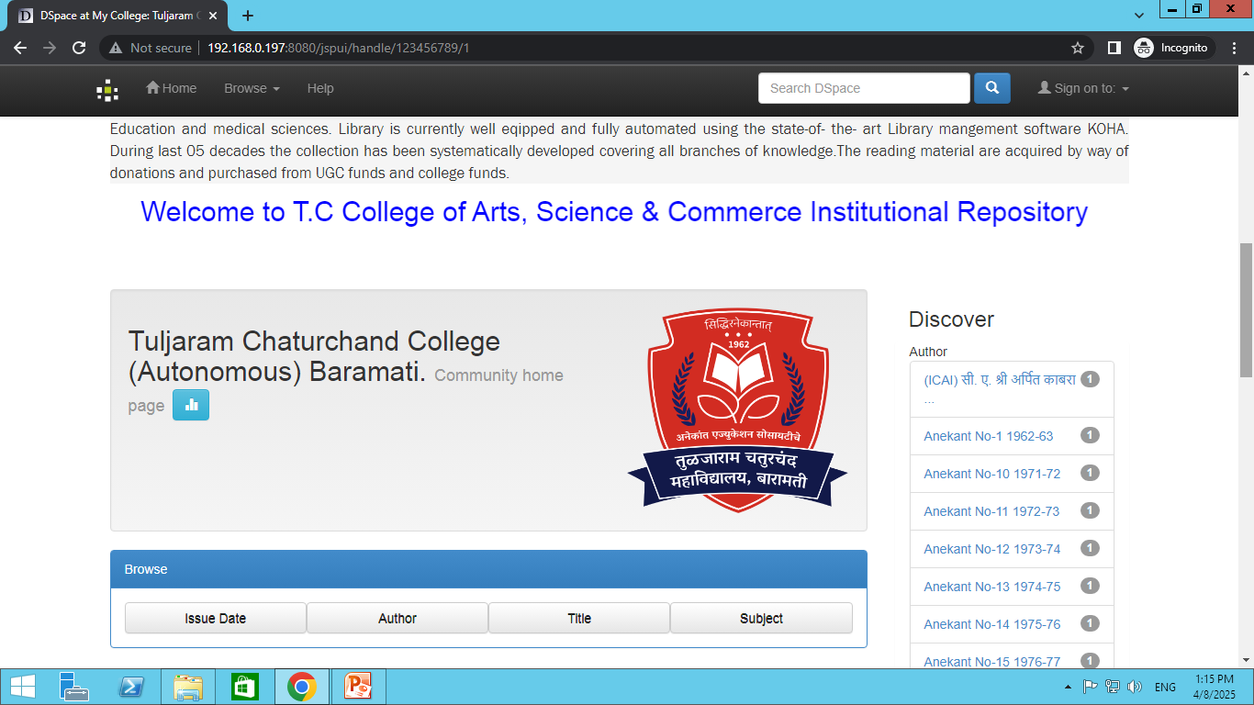
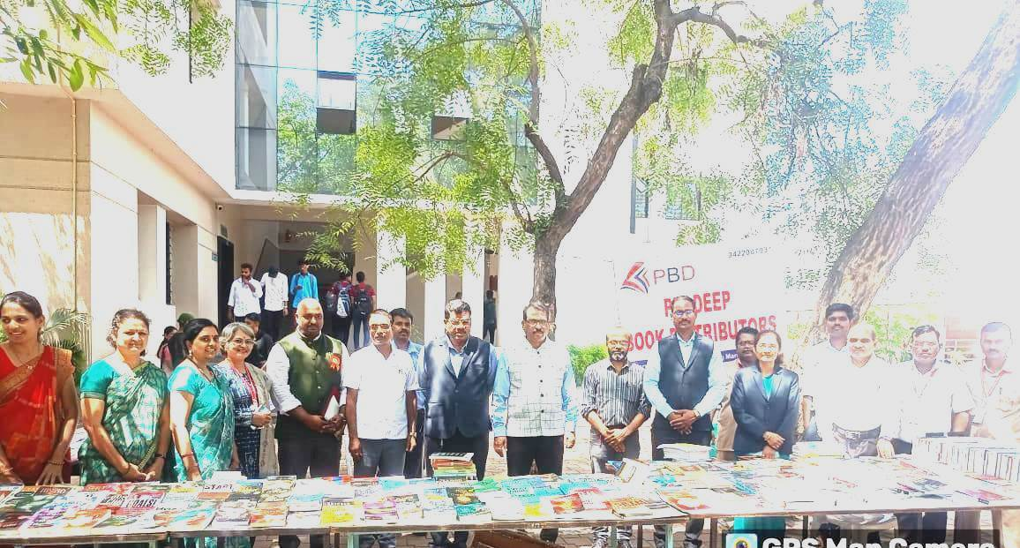
BEST PRACTICES
1. News Paper Clipping and Alert Service
3.Updated Library Online Repository
2.Book Exhibition/ Library Orientation
4. Open Access Library
4. Monthly Best User Display

Slide 28

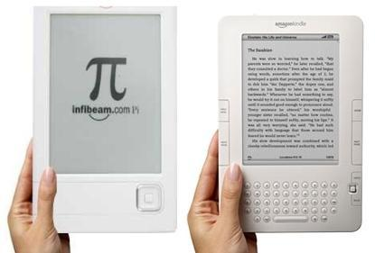
FUTURE PLANS
1. To organize workshop and training session to enhance digital literacy
2. Introduction of a mobile app for seamless access to library services
3. To introduce add on course on Information Literacy, OERs etc.
4. Establishing more collaboration with other libraries for resource sharing.

Slide 29


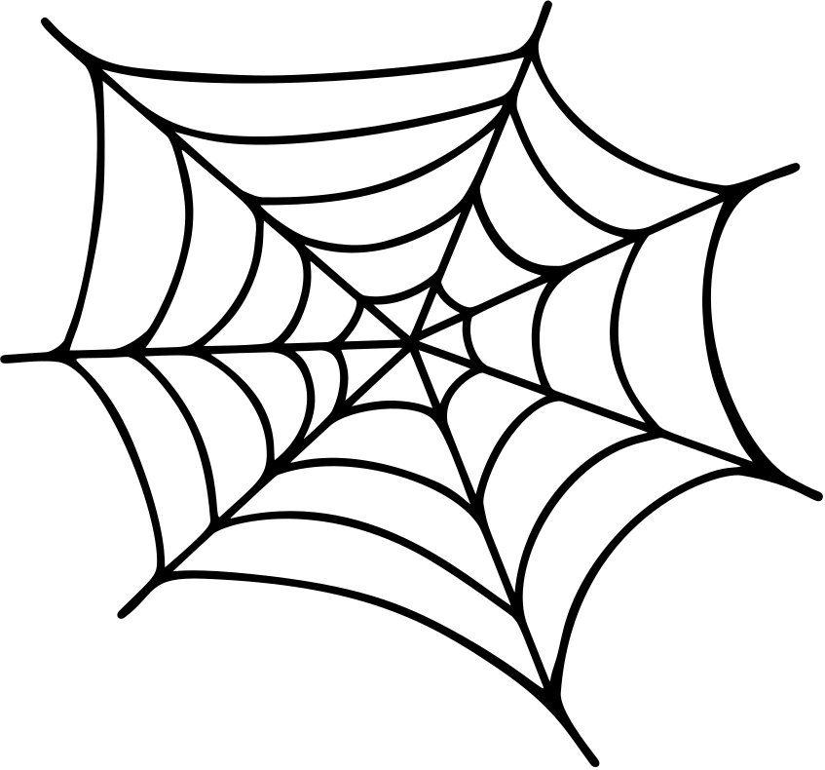

Connect the Library through
LIBRARY WEBPAGE
https://www.tccollege.org/infrastructure/library/
INSTITUTIONAL REPOSITORY
https://www.http://192.168.0.197:8080/jspui/k
WEB OPAC (Online Public Access Catalogue)
https://www.http://http://192.168.0.197:8000/
On Social Media through Facebook, WhatsApp and Telegram groups
https://www.facebook.com/share/p/1EBKXyL8hB/?mibextid=oFDknk

Slide 30
Thank
you!

