Slide 1
PPT ON N-List
Mrs. D. S. Bamane
Librarian
TC College Baramati.

Slide 2
About N-List
The Project entitled "National Library and Information Services Infrastructure for Scholarly Content (N-LIST)", being jointly executed by the e-ShodhSindhu Consortium, INFLIBNET Centre and the INDEST-AICTE Consortium, IIT Delhi provides for i) cross-subscription to e-resources subscribed by the two Consortia, i.e. subscription to INDEST-AICTE resources for universities and e-ShodhSindhu resources for technical institutions; and ii) access to selected e-resources to colleges. The N-LIST project provides access to e-resources to students, researchers and faculty from colleges and other beneficiary institutions through server(s) installed at the INFLIBNET Centre. The authorized users from colleges can now access e-resources and download articles required by them directly from the publisher's website once they are duly authenticated as authorized users through servers deployed at the INFLIBNET Centre.

Slide 3
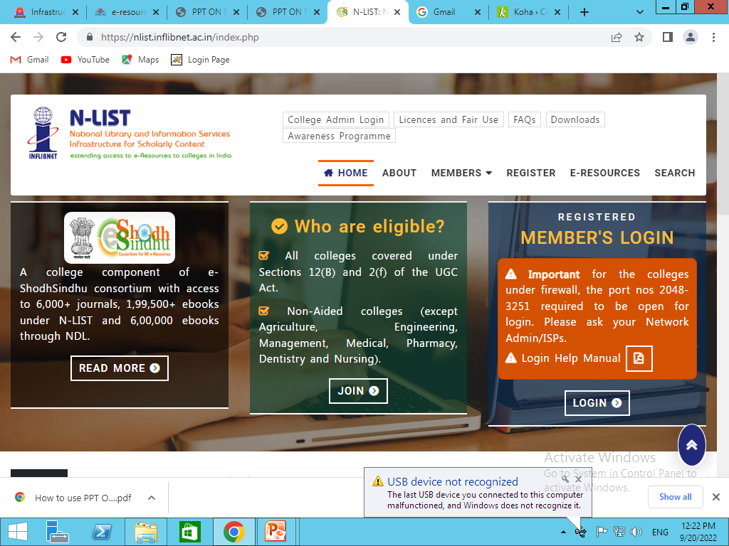
N-List Home Page

Slide 4
The N-LIST project provides access to eresources to students, researchers and faculty from colleges and other beneficiary institutions through server(s) installed at the INFLIBNET Centre. The authorized users from colleges can access e-resources and download articles or any e-resources required by them directly from the publisher's website. The N-LIST consists with a total number of 3996 colleges have registered themselves including Govt. / Govt.-aided colleges covered under the 12 B Act of the UGC as on Feb 16 2011. All e-resources subscribed for colleges under the N-LIST Project are now accessible to these 1101 colleges through the N-LIST website. Colleges will have access to electronic resources subscribed by the N-LIST Digital Library consortium or its member colleges as well as few selected eresources that were found most appropriate for colleges including e-journals and e-books. These resources include more than 6000+ e-journals and 199500+ e-books 600000 ebooks through NDL.

Slide 5
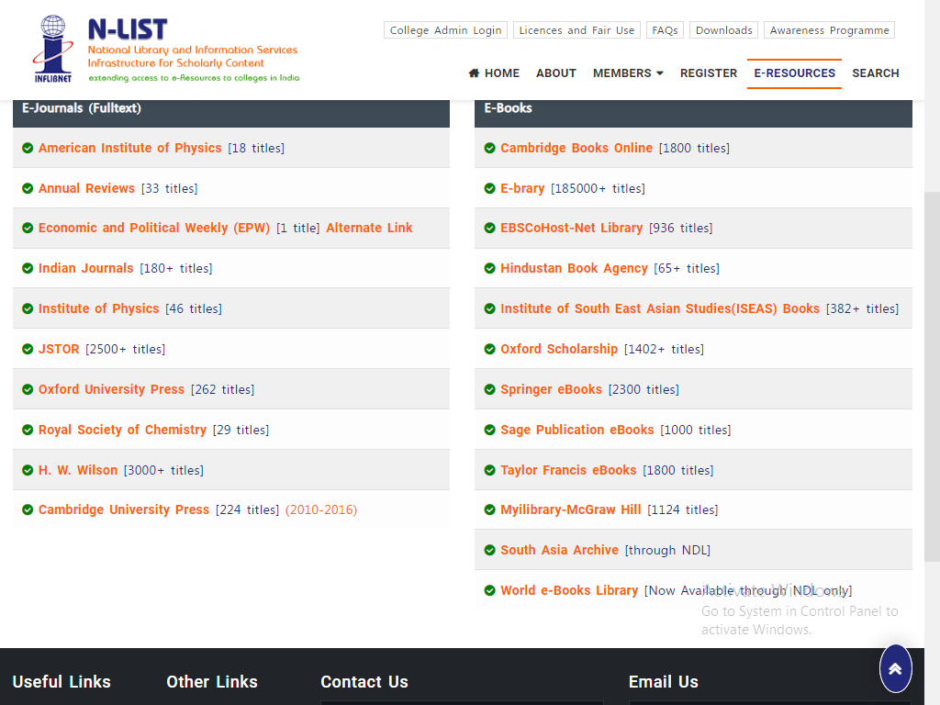
E-Journals (Full Text) & E-Books

Slide 6
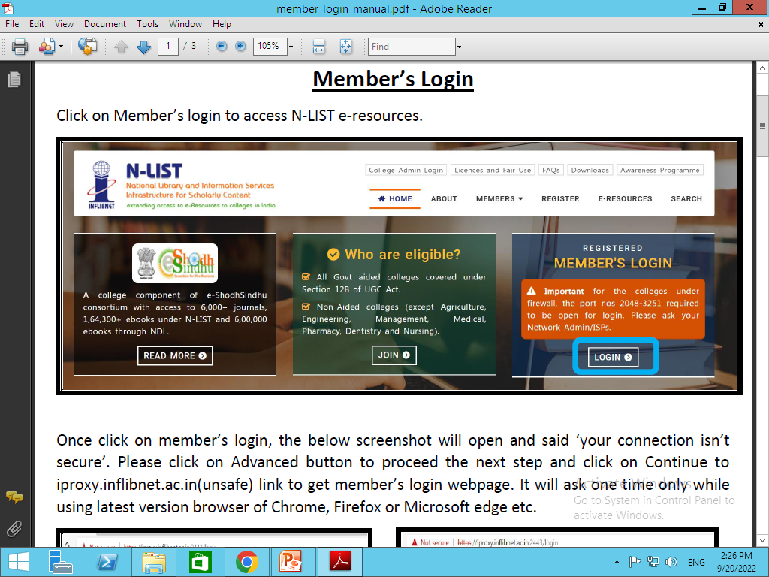
Members Login

Slide 7
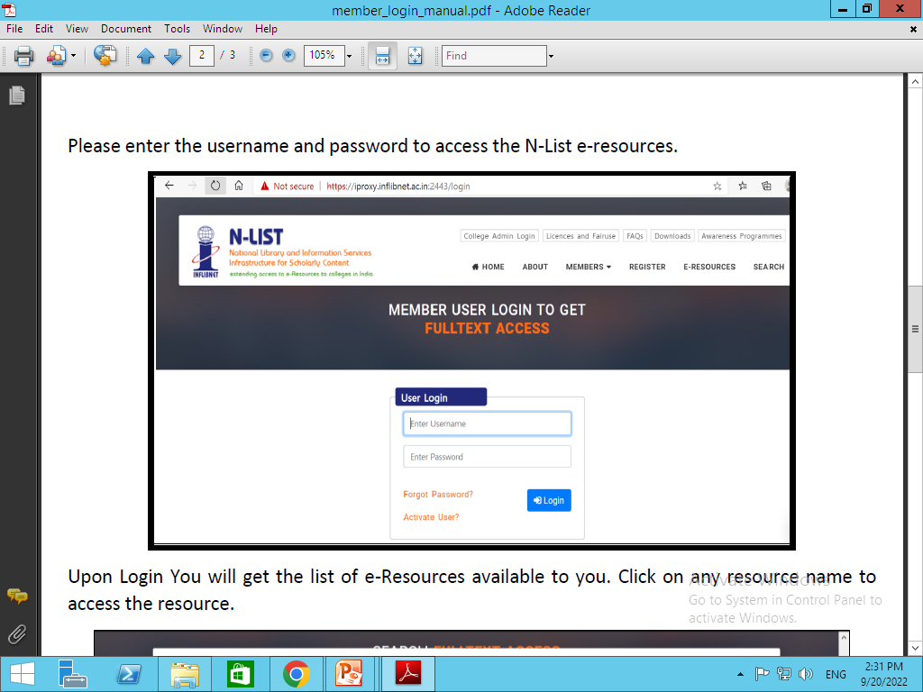

Slide 8
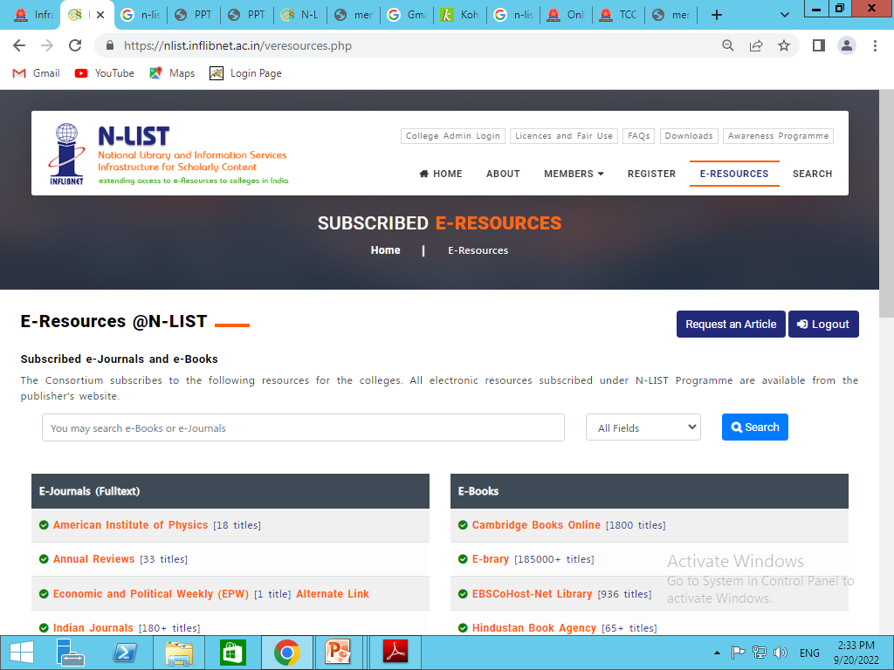
N-List Link

Slide 9
Thank You

